Slide 1
CAREER
DEMAND
Dr. Dana Jacobson
College & Career Counselor

Slide 2
TODAY WE WILL EXPLORE
Career Demand
&
College Choices

Slide 3
BY THE END OF THE PERIOD
WE SHOULD COMPLETE
Welcome to Xello
Career Demand
Choosing a College

Slide 4
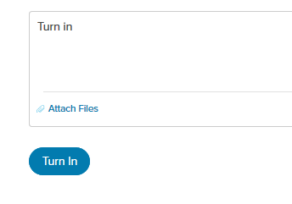
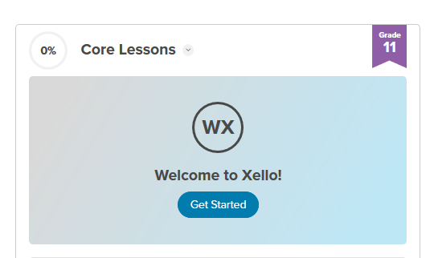
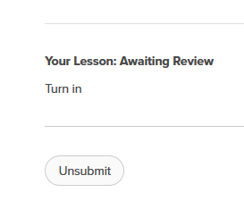
PART 1:
WELCOME
TO XELLO
2. Click blue “Turn In” Button until it changes color
to white
If you see “Welcome to Xello” in blue,
click on “Get Started”
3. Return to Xello Dashboard and you should see
a green check

Slide 5
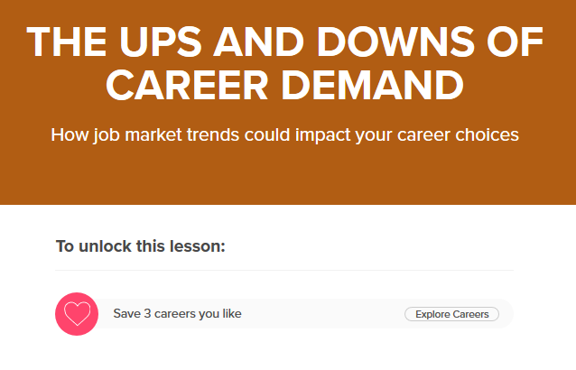
PART 2:
CAREER DEMAND
If You See This Screen:
If You See This Screen:
You MUST Save 3 Careers, then
Click Career Demand Lesson again
Click “Get Started”

Slide 6
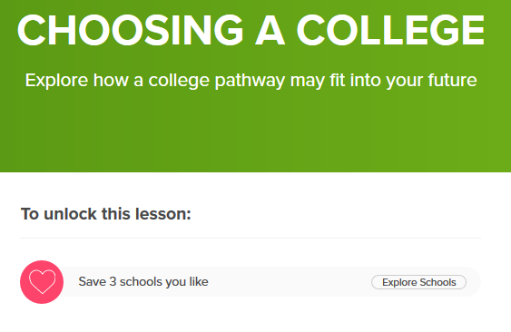
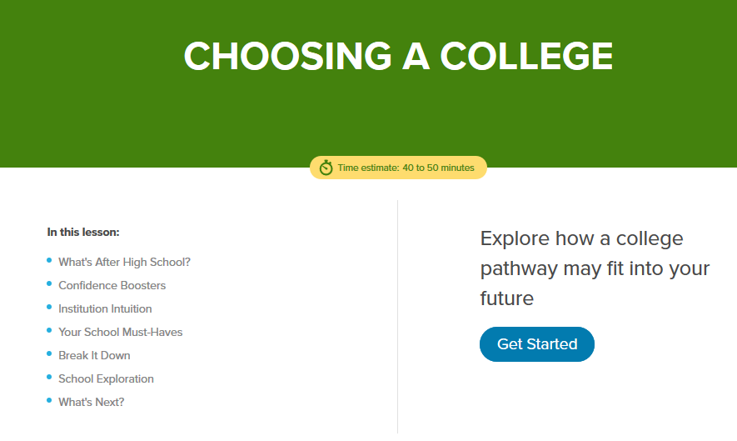
PART 3:
CHOOSING A COLLEGE
If You See This Screen:
If You See This Screen:
You MUST Save 3 Colleges,
then click Choosing a College
Lesson again
Click“Get Started”

Slide 7
GWHS Website: www.osceolaschools.net/gwhs
Class of 2022 Remind: @e2hck26
GWHS Social Media
Facebook @GatewayHighPanthers
Instagram @GatewayPanthers
Twitter @GatewayPanthers
GWHS Class of 2022 Team: xz95v36
MAKE SURE TO KEEP UP TO DATE ON INFORMATION THROUGH:

